Slide 1

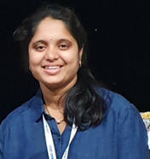

Neuro-AI alignment: Introduction
Subba Reddy Oota¹,Mounika Mareddy², Raju S. Bapi³
¹TU Berlin, Germany; ²University of Bonn, Germany; ³IIIT Hyderabad, India
subba-reddy.oota@inria.fr; raju.bapi<AT>iiit.ac.in
Thanks to Dr. Manish Gupta, Microsoft India for the slides

Slide 2
Agenda
09.30 AM – 11.15 AM Bapi Raju Neuro-AI alignment: Introduction
11:30 AM – 1.00 PM Mounika Marreddy Recent trends in LLMs
11.15 AM – 11.30 AM Coffee Break
1.00 PM – 2.00 PM Lunch Break
2.00 PM – 3.30 PM Subba Reddy Similarities and differences between language processing in brains and machines
3.30 PM – 3.45 PM Coffee Break
3.45 PM – 5.45 PM Subba & Mounika Hands-on-session

Slide 3
Agenda
Neuro-AI Alignment: Introduction
Brain Encoding/Decoding: Techniques and Research Goals
Introduction to popular text datasets
Text Stimulus Representations

Slide 4
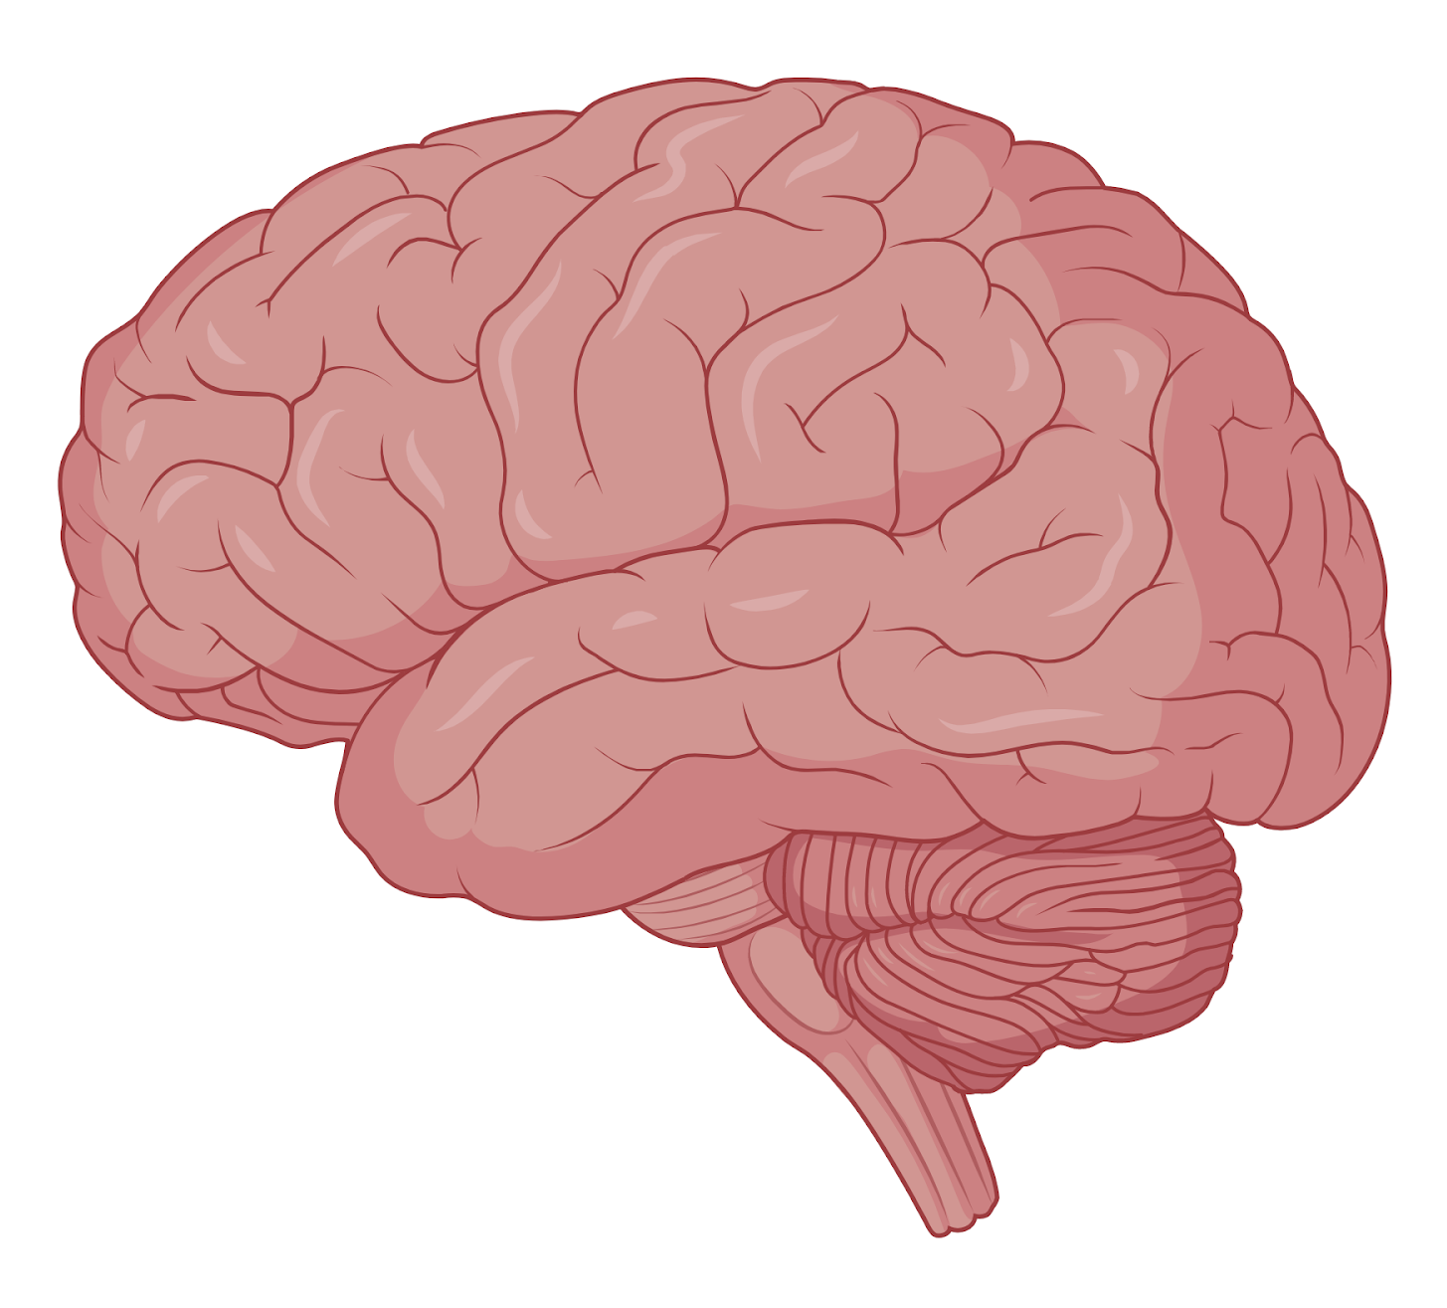
Neuroscience
Field of science that studies the structure and function of the nervous system of different species.
Involves answering interesting questions
How learning occurs during adolescence, and how it differs from the way adults learn and form memories.
Which specific cells in the brain (and what connections they form with other cells), have a role in how memories are formed.
How animals cancel out irrelevant information arriving from the senses and focus only on information that matters.
How do humans make decisions.
How humans develop speech and learn languages.
Neuroscientists study diverse topics that help us understand how the brain and nervous system work.

Slide 5
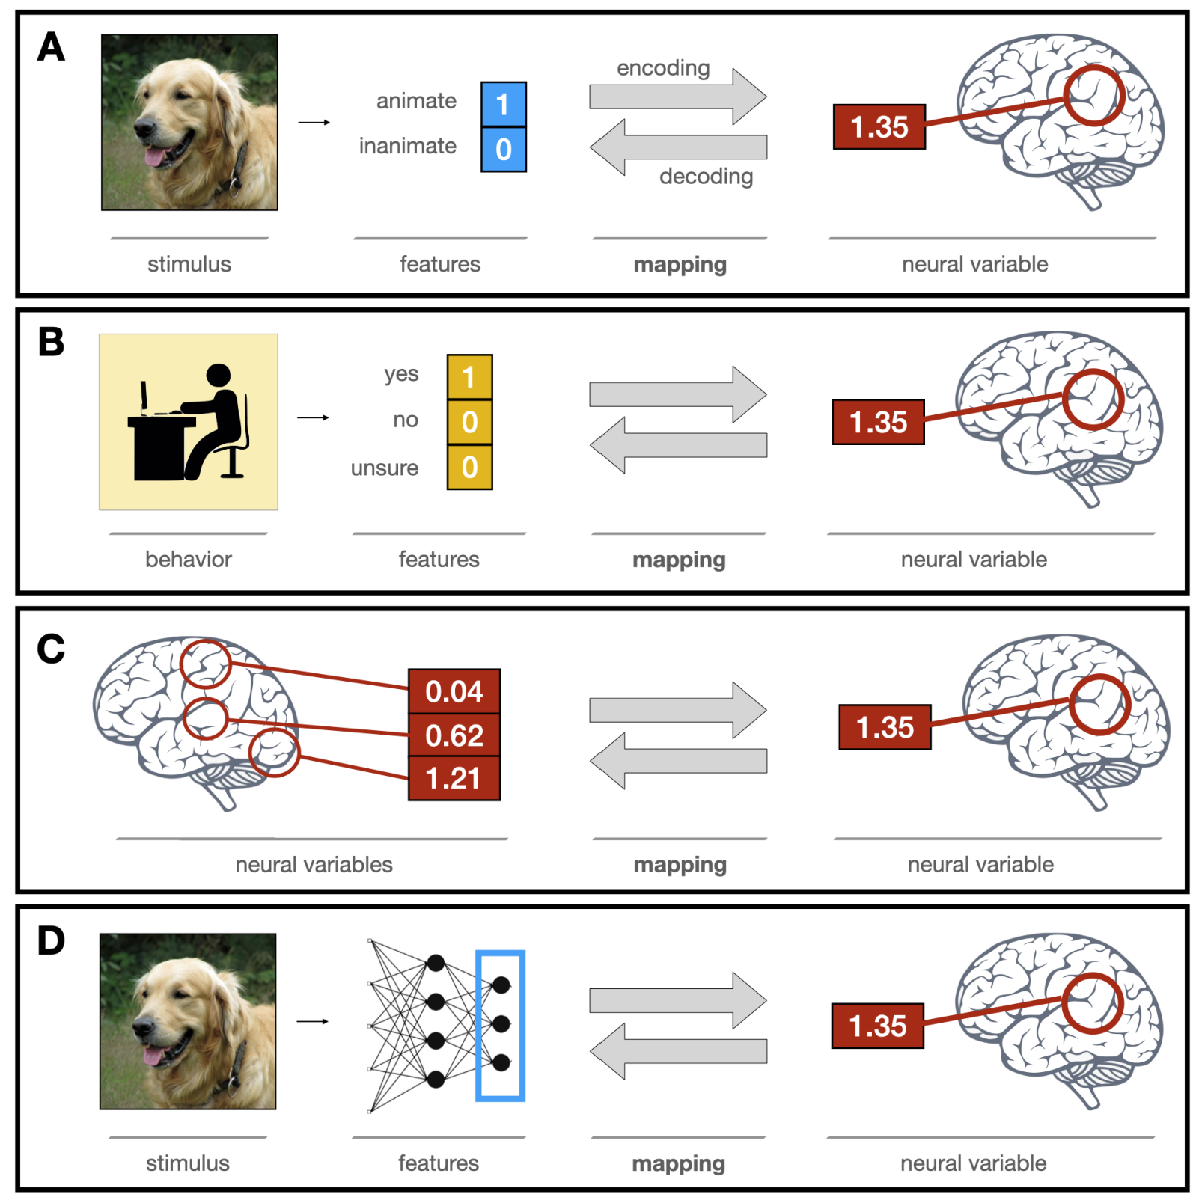
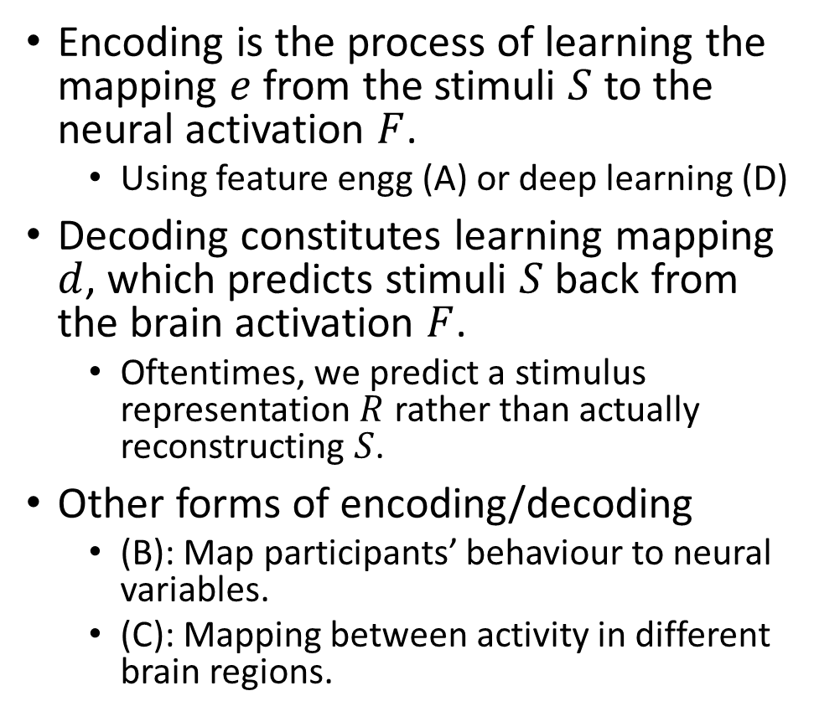
Brain encoding and decoding in cognitive neuroscience
Encoding is the process of learning the mapping $e$ from the stimuli $S$ to the neural activation $F$.
Using feature engg (A) or deep learning (D)
Decoding constitutes learning mapping $d$, which predicts stimuli $S$ back from the brain activation $F$.
Oftentimes, we predict a stimulus representation $R$ rather than actually reconstructing $S$.
Other forms of encoding/decoding
(B): Map participants’ behaviour to neural variables.
(C): Mapping between activity in different brain regions.
Ivanova, Anna A., Martin Schrimpf, Stefano Anzellotti, Noga Zaslavsky, Evelina Fedorenko, and Leyla Isik. "Is it that simple? Linear mapping models in cognitive neuroscience." bioRxiv (2021).

Slide 6
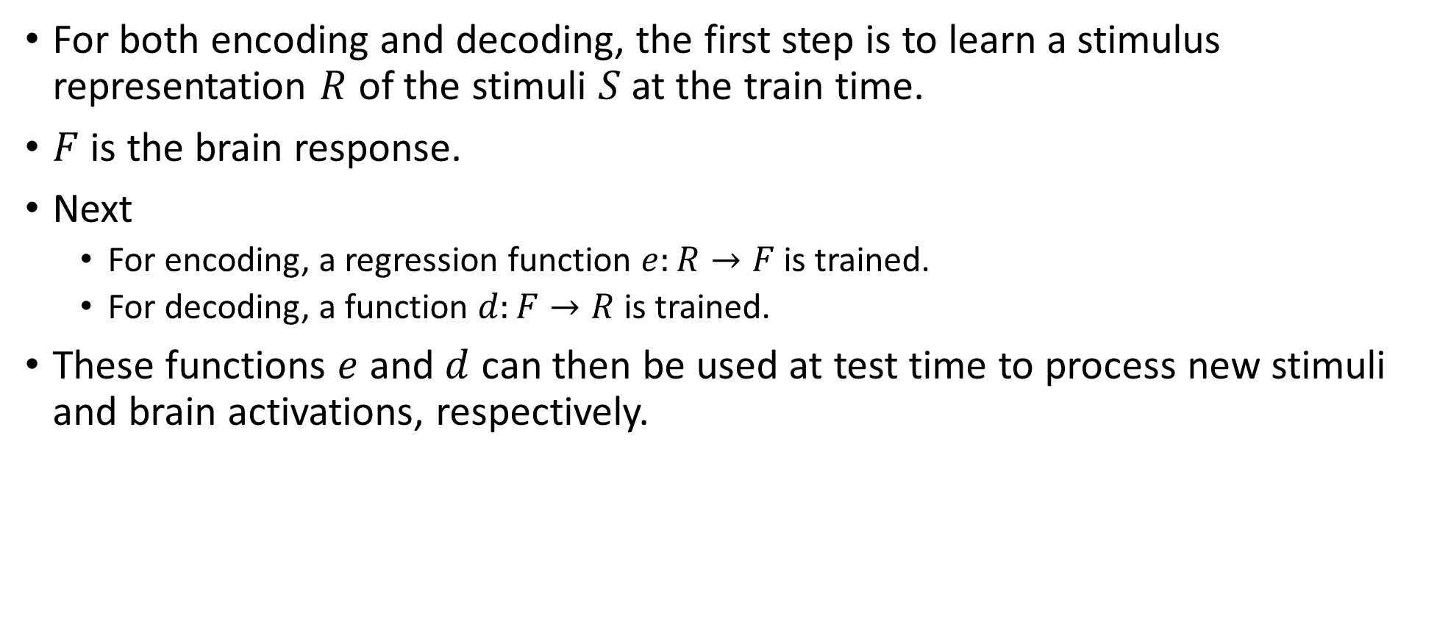
Brain encoding and decoding
For both encoding and decoding, the first step is to learn a stimulus representation $R$ of the stimuli $S$ at the train time.
$F$ is the brain response.
Next
For encoding, a regression function $e:R→F$ is trained.
For decoding, a function $d:F→R$ is trained.
These functions $e$ and $d$ can then be used at test time to process new stimuli and brain activations, respectively.

Slide 7
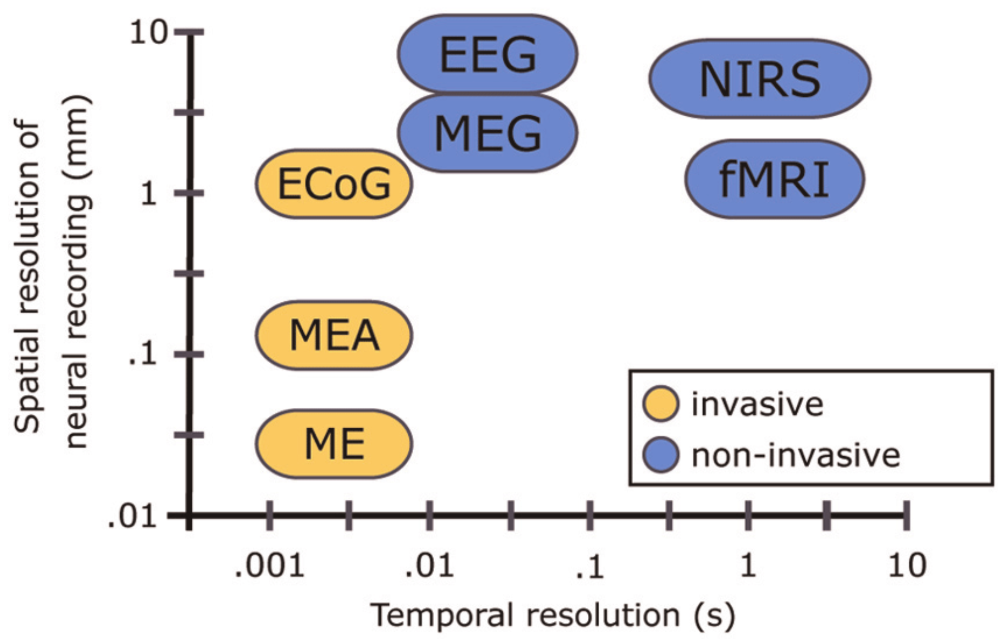
Techniques for studying the brain function
fMRI: high spatial but low time resolution.
Good to study a specific location in the brain
Unsuitable for sentence-level analysis. fMRI takes about two seconds to complete a scan. This is far lower than the speed at which humans can process language.
Cannot capture syntactic information (Gauthier and Levy, 2019)
EEG: high time but low spatial resolution.
Can preserve rich syntactic information (Hale et al., 2018)
But cannot use for source analysis.
fNIRS: compromise option
Time resolution better than fMRI
Spatial resolution better than EEG
Balance of spatial and temporal resolution may not be enough to compensate for the loss in both.
Single Micro-Electrode (ME), Micro-Electrode array (MEA), Electro-Cortico Graphy (ECoG), Positron emission tomography (PET), functional MRI (fMRI), Magneto-encephalography (MEG), Electro-encephalography (EEG), Near-Infrared Spectroscopy (NIRS)
Vogel, Jörn, Sami Haddadin, Beata Jarosiewicz, John D. Simeral, Daniel Bacher, Leigh R. Hochberg, John P. Donoghue, and Patrick van der Smagt. "An assistive decision-and-control architecture for force-sensitive hand–arm systems driven by human–machine interfaces." The International Journal of Robotics Research 34, no. 6 (2015): 763-780.
Notes:
FMRI scans use the same basic principles of atomic physics as MRI scans, but MRI scans image anatomical structure whereas FMRI image metabolic function. Thus, the images generated by MRI scans are like three dimensional pictures of anatomic structure. The images generated by FMRI scans are images of metabolic activity within these anatomic structures.

Slide 8
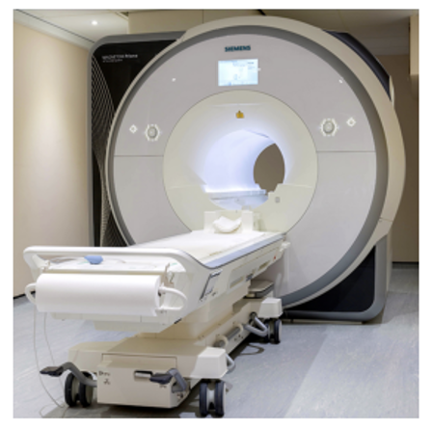
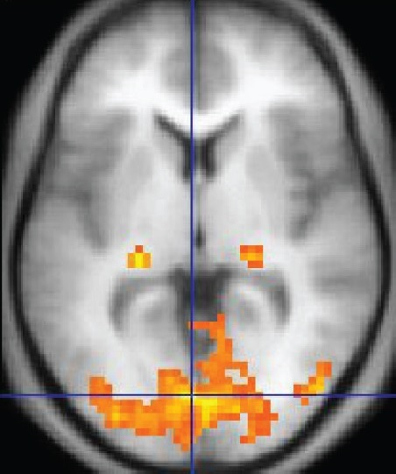
fMRI
No injections, surgery, the ingestion of substances, or exposure to ionizing radiation.
The primary form of fMRI uses the blood-oxygen-level dependent (BOLD) contrast, discovered by Seiji Ogawa in 1990.
Measures brain activity by detecting changes associated with blood flow.
When an area of the brain is in use, blood flow to that region also increases.
Hemodynamic response (HRF)
It takes a while for the vascular system to respond to the brain's need for glucose.
Blood flow lags the neuronal events triggering it by about 5 seconds.
An fMRI image with yellow areas showing increased activity compared with a control condition

Slide 9
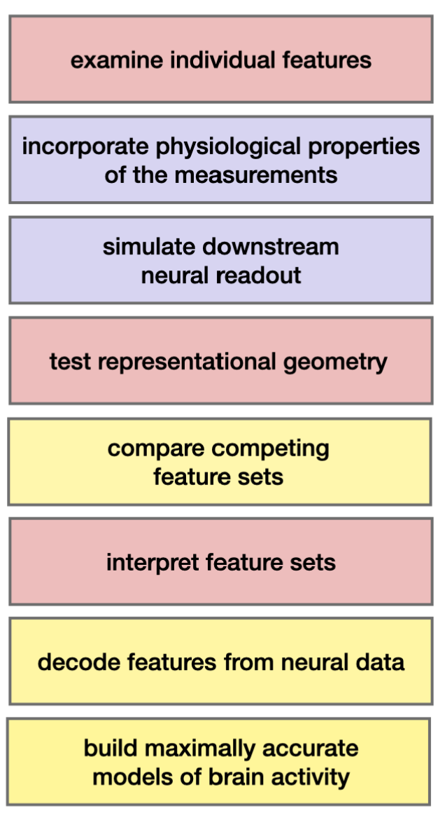
Computational Cognitive Science Research goals
Predictive Accuracy
Compare feature sets: Which feature set provides the most faithful reflection of the neural representational space?
Test feature decodability: “Does neural data Y contain information about features X?”
Build accurate models of brain data: Aim is to enable simulations of neuroscience experiments.
Interpretability
Examine individual features: Which features contribute the most to neural activity?
Test correspondences between representational spaces
“CNNs vs ventral visual stream” or “Two text representations”
Interpret feature sets
Do features X, generated by a known process, accurately describe the space of neural responses Y?
Do voxels respond to a single feature or exhibit mixed selectivity?
How does the mapping relate to other models or theories of brain function?
Ivanova, Anna A., Martin Schrimpf, Stefano Anzellotti, Noga Zaslavsky, Evelina Fedorenko, and Leyla Isik. "Is it that simple? Linear mapping models in cognitive neuroscience." bioRxiv (2021).

Slide 10
Computational Cognitive Science Research goals
Biological plausibility
Simulate linear readout
If the features can be extracted with a linear mapping model, it means that they require few additional computations in order to be used downstream.
Incorporate measurement-related considerations
Rather than assuming a fixed HRF across voxels and/or conditions, what are better ways?
Ivanova, Anna A., Martin Schrimpf, Stefano Anzellotti, Noga Zaslavsky, Evelina Fedorenko, and Leyla Isik. "Is it that simple? Linear mapping models in cognitive neuroscience." bioRxiv (2021).

Slide 11
Agenda
Neuro-AI Alignment: Introduction
Brain Encoding/Decoding: Techniques and Research Goals
Introduction to popular text datasets
Text Stimulus Representations

Slide 12
Forms of stimulus presentation and data collection
Type: fMRI, EEG, MEG, …
TR: Sampling time.
Fixation points: location, color, shape.
Form of stimuli presentation: text, video, audio, images.
Task: question answering, property generation, understanding, …
Time given to participants: 1 minute to list properties, …
Type of participants: males/females, sighted/blind, …
Number of times the response to stimuli was recorded.
Language

Slide 13
Text Stimulus Datasets
Dataset | Type | Language | Stimulus | #Subjects | Paradigm | Size | Task
Wehbe et al., 2014 | fMRI | English | Chapter 9 of Harry Potter and the Sorcerer's Stone | 9 | Reading stories | 5000 word chapter was presented in 45 minutes. | Story understanding
Handjaras et al., 2016 | fMRI | Italian | Verbal, pictorial or auditory presentation of 40 concrete nouns | 20 | Reading, viewing or listening | 40 nouns * 4 times. | Property Generation
Anderson et al., 2017 | fMRI | Italian | 70 concrete and abstract nouns from law/music. | 7 | Reading | 70 nouns * 5 times. | Imagine a situation that they personally associate with the noun
Zurich Cognitive Language Processing Corpus (ZuCo): Hollenstein et al., 2018 | EEG and eye-tracking | English | Sentences from movie reviews or Wikipedia | 12 | Reading natural sentences | 21,629 words in 1107 sentences and 154,173 fixations | Rate movie quality, answer control questions, check for existence of a relation
Anderson et al., 2019 | fMRI | English | 240 active voice sentences describing everyday situations | 14 | Reading | 240 sentences seen 12 times (by 10 subjects) and 6 times (by 4 subjects) | Passive reading
BCCWJ-EEG: Oseki and Asahara, 2020 | EEG | Japanese | 20 newspaper articles | 40 | Reading | 1 time reading for ~30-40 minutes | Passive reading

Slide 14
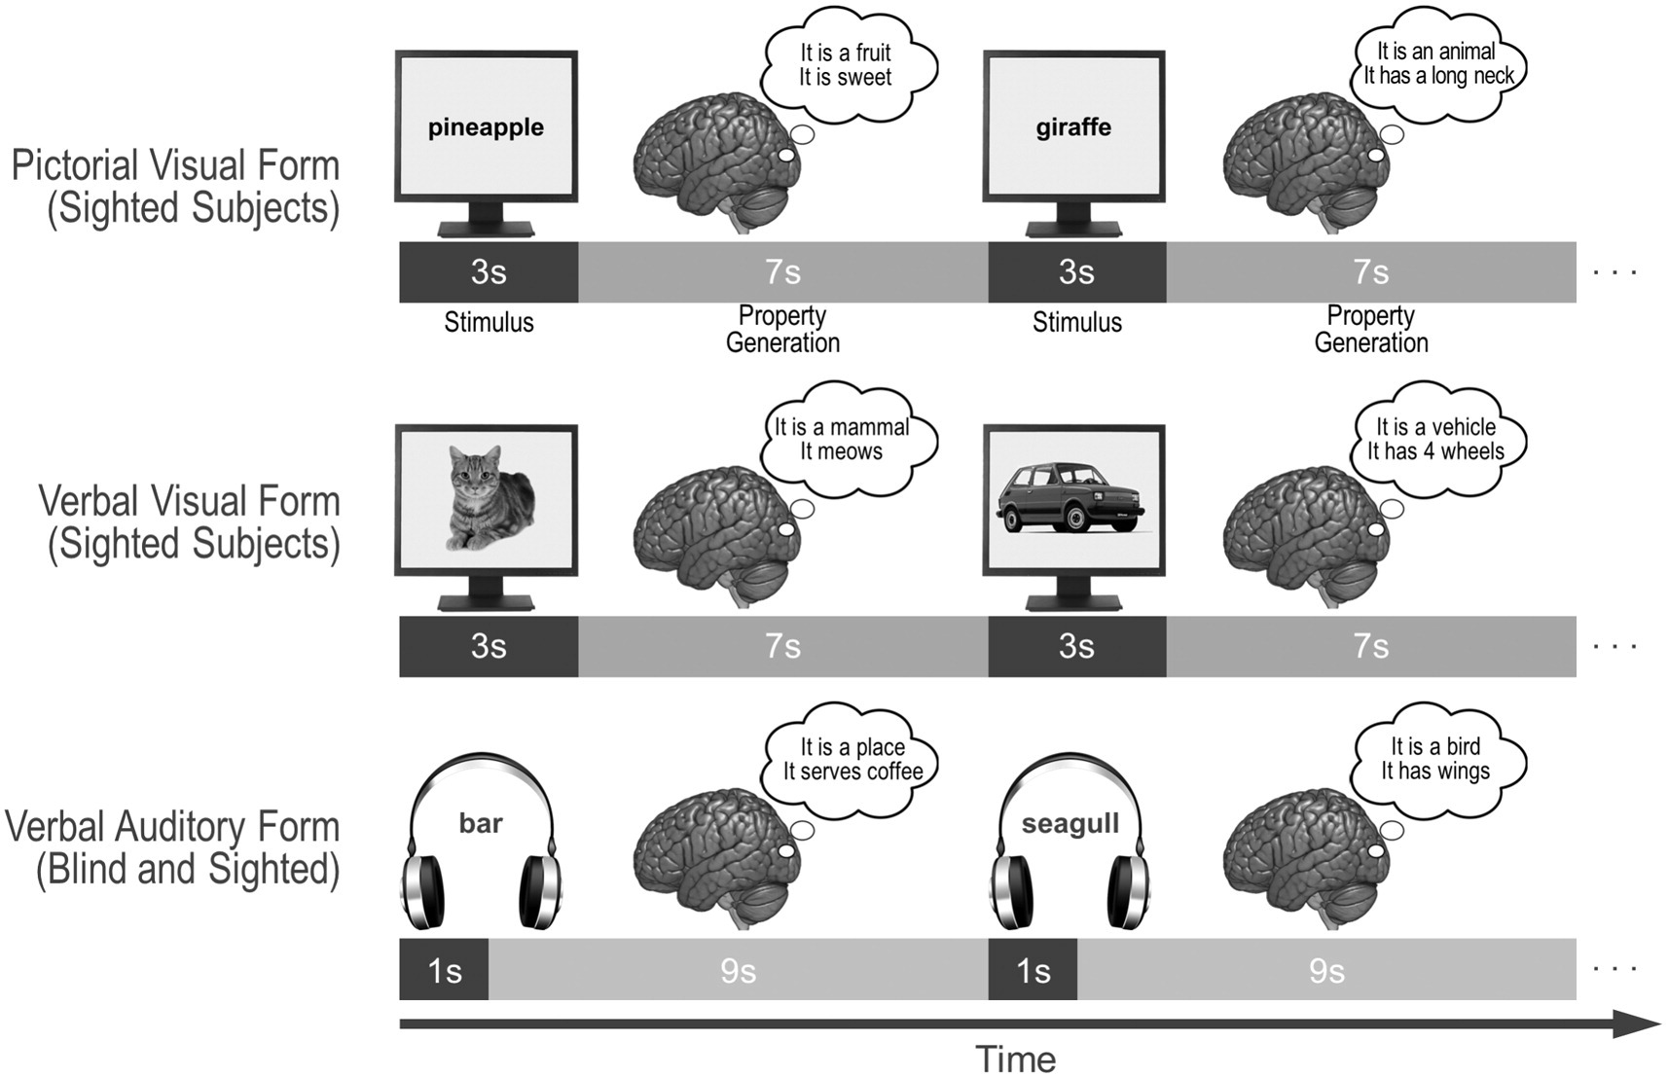
Data for concrete nouns from sighted/blind subjects
Participants were asked to verbally enumerate in one minute the properties (features) that describe the entities the words refer to.
4 groups of participants
5 sighted individuals were presented with a pictorial form of the nouns
5 sighted individuals with a verbal visual (i.e., written Italian words) form
5 sighted individuals with a verbal auditory (i.e., spoken Italian words) form
5 congenitally blind with a verbal auditory form.
Handjaras, Giacomo, Emiliano Ricciardi, Andrea Leo, Alessandro Lenci, Luca Cecchetti, Mirco Cosottini, Giovanna Marotta, and Pietro Pietrini. "How concepts are encoded in the human brain: a modality independent, category-based cortical organization of semantic knowledge." Neuroimage 135 (2016): 232-242.

Slide 15
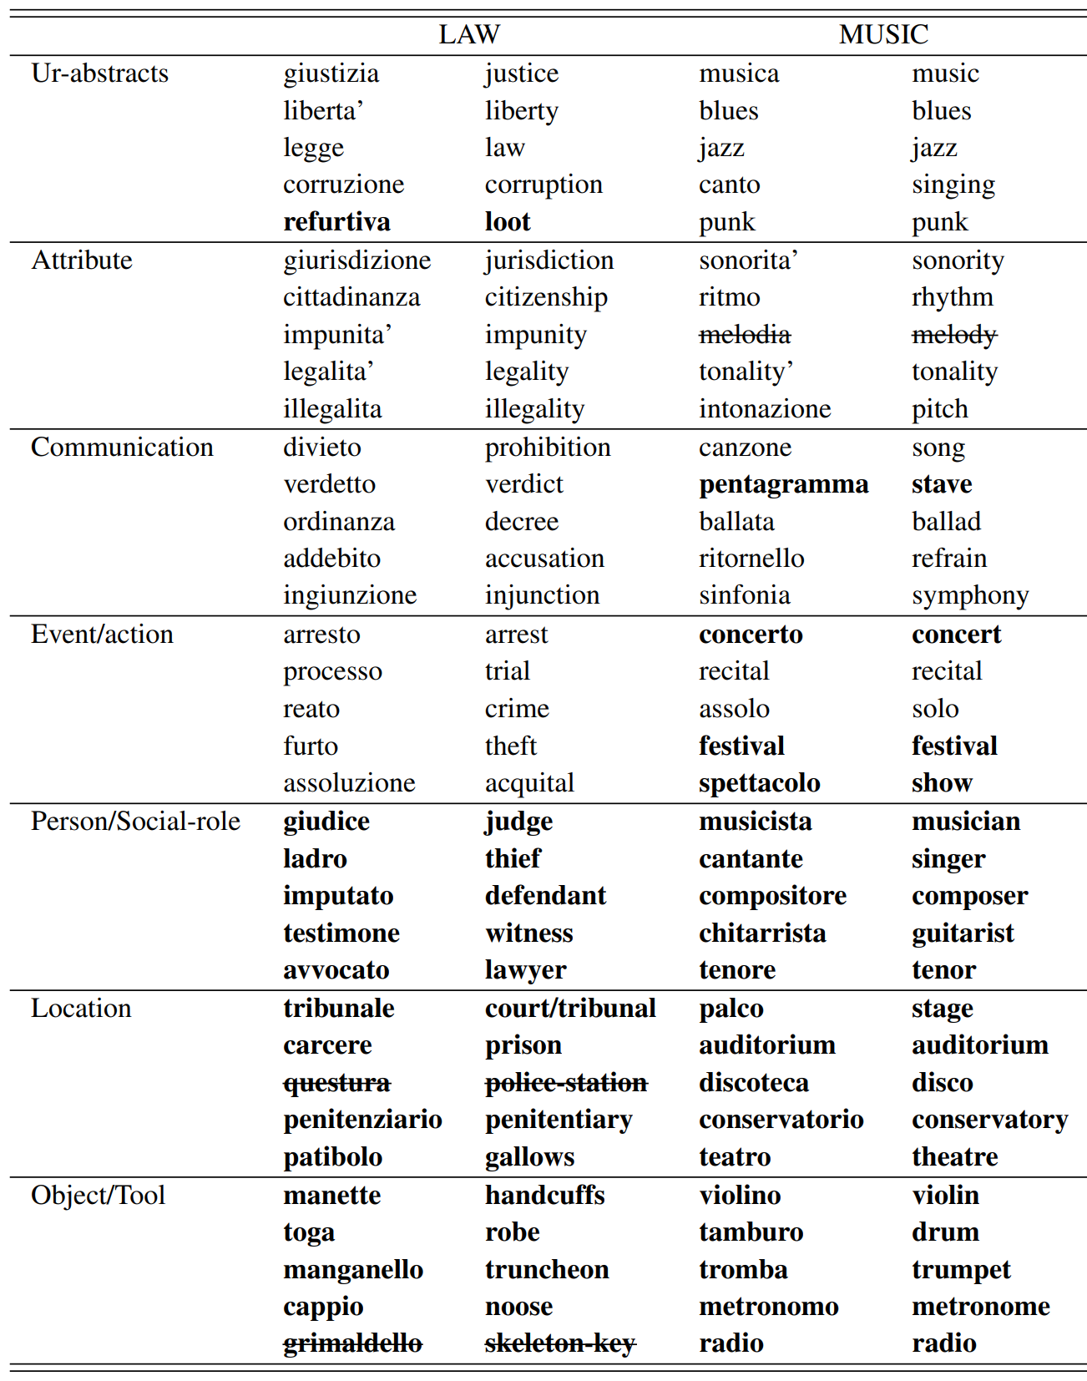
70 - Italian word stimuli fMRI data
Taxonomic categories in law and music domain
Ur-abstract: that are classified as abstract in WordNet
Attribute: A construct whereby objects or individuals can be distinguished
Communication: Something that is communicated by, to or between groups
Event/action: Something that happens at a given place and time
Person/Social role: Individual, someone, somebody, mortal
Location: Points or extents in space
Object/Tool: A class of unambiguously concrete nouns
Participants asked to imagine a situation that they personally associate with the noun
Anderson, Andrew J., Douwe Kiela, Stephen Clark, and Massimo Poesio. "Visually grounded and textual semantic models differentially decode brain activity associated with concrete and abstract nouns." Transactions of the Association for Computational Linguistics 5 (2017): 17-30.

Slide 16
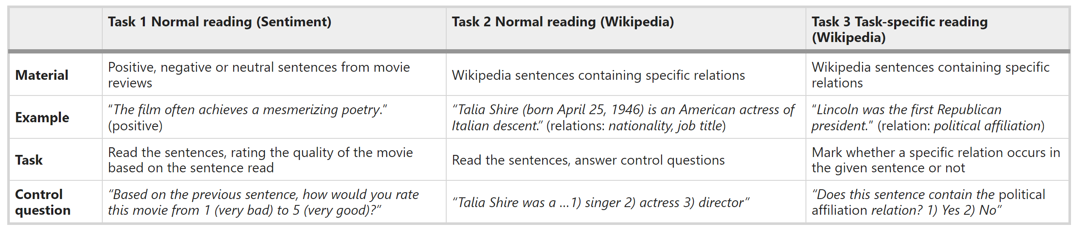
Zurich Cognitive Language Processing Corpus (ZuCo)
Personal reading speed.
Sentences were presented to the subjects in a naturalistic reading scenario
Complete sentence is presented on the screen
Subjects read each sentence at their own speed, i.e., the reader determines for how long each word is fixated and which word to fixate next.
EEG and eye tracking data acquired.
Hollenstein, Nora, Jonathan Rotsztejn, Marius Troendle, Andreas Pedroni, Ce Zhang, and Nicolas Langer. "ZuCo, a simultaneous EEG and eye-tracking resource for natural sentence reading." Scientific data 5, no. 1 (2018): 1-13.

Slide 17
Text Stimulus Datasets References
Wehbe, Leila, Brian Murphy, Partha Talukdar, Alona Fyshe, Aaditya Ramdas, and Tom Mitchell. "Simultaneously uncovering the patterns of brain regions involved in different story reading subprocesses." PloS one 9, no. 11 (2014): e112575.
Hollenstein, Nora, Jonathan Rotsztejn, Marius Troendle, Andreas Pedroni, Ce Zhang, and Nicolas Langer. "ZuCo, a simultaneous EEG and eye-tracking resource for natural sentence reading." Scientific data 5, no. 1 (2018): 1-13.
Handjaras, Giacomo, Emiliano Ricciardi, Andrea Leo, Alessandro Lenci, Luca Cecchetti, Mirco Cosottini, Giovanna Marotta, and Pietro Pietrini. "How concepts are encoded in the human brain: a modality independent, category-based cortical organization of semantic knowledge." Neuroimage 135 (2016): 232-242.
Anderson, Andrew J., Douwe Kiela, Stephen Clark, and Massimo Poesio. "Visually grounded and textual semantic models differentially decode brain activity associated with concrete and abstract nouns." Transactions of the Association for Computational Linguistics 5 (2017): 17-30.
Anderson, Andrew James, Jeffrey R. Binder, Leonardo Fernandino, Colin J. Humphries, Lisa L. Conant, Rajeev DS Raizada, Feng Lin, and Edmund C. Lalor. "An integrated neural decoder of linguistic and experiential meaning." Journal of Neuroscience 39, no. 45 (2019): 8969-8987.
Oseki, Yohei, and Masayuki Asahara. "Design of BCCWJ-EEG: Balanced corpus with human electroencephalography." In Proceedings of the 12th Language Resources and Evaluation Conference, pp. 189-194. 2020.

Slide 18
Agenda
Neuro-AI Alignment: Introduction
Brain Encoding/Decoding: Techniques and Research Goals
Introduction to popular text datasets
Text Stimulus Representations

Slide 19
Text Stimulus Representations
Basic NLP Representations
Corpus co-occurrence counts
Topic models
Linguistic: POS, dependencies, roles.
Discourse
Characters, motion, speech, emotions, non-motion verbs
Deep Learning based Representations
Embeddings
Longer context using LSTMs
Transformers
Experiential attributes
Rated on 0-6 scale
Binary

Slide 20
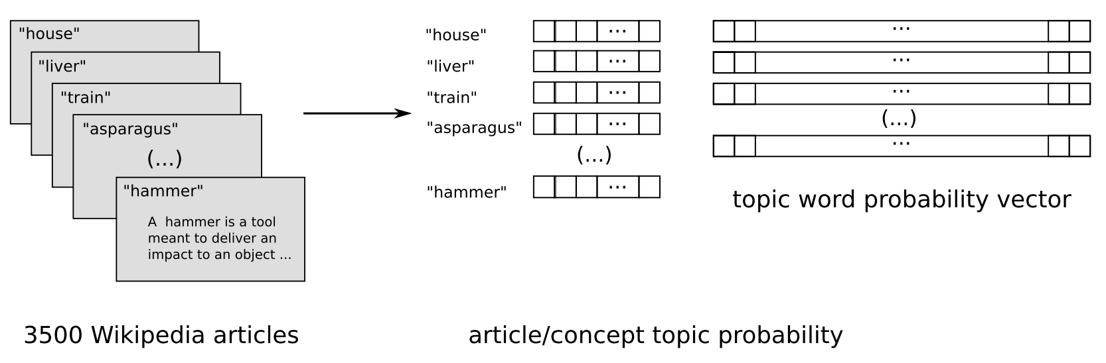
Basic NLP Representations for Word Stimuli
Corpus co-occurrence counts
25 verbs (Mitchell et al., 2008; Pereira et al., 2013)
Verbs: see, hear, listen, taste, smell, eat, touch, nib, lift, manipulate, run, push, fill, move, ride, say, fear, open, approach, near, enter, drive, wear, break, and clean.
These verbs generally correspond to basic sensory and motor activities, actions performed on objects, and actions involving changes to spatial relationships.
For each (verb, stimulus word w), feature value = normalized co-occurrence count of w with any of three forms of the verb (e.g., taste, tastes, or tasted) over the text corpus.
985 common English words (such as above, worry, and mother) in (Huth et al., 2016).
Topic models (Pereira et al., 2013)
Get relevant Wiki pages (e.g., “airplane” is “Fixed-Wing Aircraft”) and other linked pages (e.g. “Aircraft cabin”)
LDA topic modelling on 3500 pages with #topics from 10 to 100, in increments of 5, setting the α parameter to 25/#topics.
LSA topic modelling (Wang et al., 2017)

Slide 21
Basic NLP Representations for Word Stimuli
Word length
Is the word related to one of the 28 unique parts of speech and 17 unique dependency relationships?
Position of word in the sentence
Roles
Main verb
Agent or experiencer
Patient or recipient
Predicate of a sentence (The window was dusty)
Modifier (The angry activist broke the chair)
Complement in adjunct and propositional phrase, including direction, location, and time (The restaurant was loud at night).
Wehbe, Leila, Brian Murphy, Partha Talukdar, Alona Fyshe, Aaditya Ramdas, and Tom Mitchell. "Simultaneously uncovering the patterns of brain regions involved in different story reading subprocesses." PloS one 9, no. 11 (2014): e112575.
Wang, Jing, Vladimir L. Cherkassky, and Marcel Adam Just. "Predicting the brain activation pattern associated with the propositional content of a sentence: modeling neural representations of events and states." Human brain mapping 38, no. 10 (2017): 4865-4881.

Slide 22
Discourse features (for Harry Potter dataset)
Characters: Resolve all pronouns to the character to whom they refer, and make binary features to signal which of the 10 characters are mentioned.
Motions: Identify a set of motions that occurred frequently in the chapter (e.g. fly, manipulate, collide physically, etc.).
Speech: Indicate the parts of the story that correspond to direct speech between the characters. Used the presence of dialog as a feature.
Emotions: Identified a set of emotions that were felt by the characters in the chapter (e.g. annoyance, nervousness, pride, etc.).
Verbs: Identified a set of actions that occurred frequently in the chapter that were distinct from motion (e.g. hear, know, see, etc.).
Wehbe, Leila, Brian Murphy, Partha Talukdar, Alona Fyshe, Aaditya Ramdas, and Tom Mitchell. "Simultaneously uncovering the patterns of brain regions involved in different story reading subprocesses." PloS one 9, no. 11 (2014): e112575.
Wang, Jing, Vladimir L. Cherkassky, and Marcel Adam Just. "Predicting the brain activation pattern associated with the propositional content of a sentence: modeling neural representations of events and states." Human brain mapping 38, no. 10 (2017): 4865-4881.

Slide 23
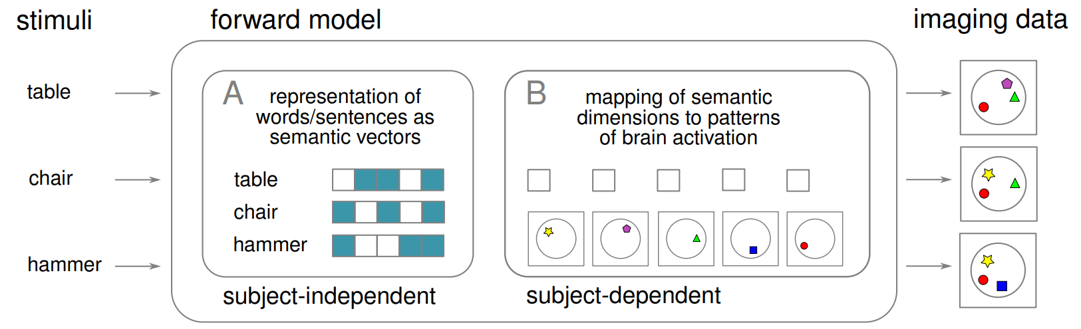
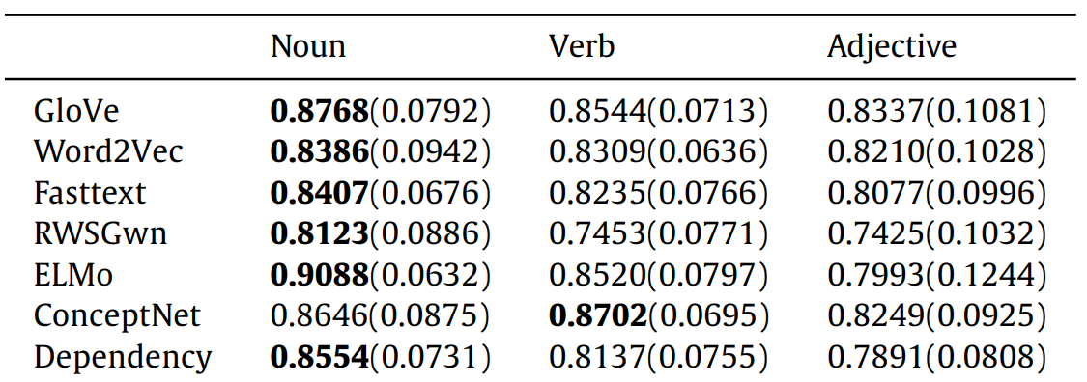
DL Representations: Using embeddings for word stimuli
GloVe 300D vectors (Pereira et al., 2016; Wang et al., 2017; Pereira et al., 2018; Anderson et al., 2019)
1000D Non-negative sparse embeddings (Wehbe et al., 2014).
300D embeddings by training a skip-gram model using negative sampling (SGNS) on Italian and English Wikipedia dumps using Gensim. (Anderson et al., 2017a)
FastText (Berezutskaya et al., 2020)
Comparison across multiple embedding methods
GloVe, word2vec, WordNet2Vec, FastText, ELMo (Hollenstein et al., 2019)
word2Vec, fastText, GloVe, Dependency-based word2vec, RWSGwn, ConceptNet, ELMo, averaged and concatenated combinations (Wang et al., 2020)
Notes:
Dependency-based Word2Vec: The dependency-based Word2Vec introduced in [22] is a Word2Vec model in which the context of the words is computed based on the dependency relations.
fastText: fastText is a modification of Word2Vec that takes morphological information into account
GloVe is a count-based method that performs a dimensionality reduction on the cooccurrence matrix
RWSGwn: RWSGwn embeddings are computed on WordNet with random walks and dimensionality reduction techniques
ConceptNet: ConceptNet is a knowledge graph that connects words and phrases of natural language with labeled edges, representing the general knowledge involved in understanding language. The ConceptNet embeddings are computed on a ConceptNet graph using the PPMI (Positive Pointwise Mutual Information) method.

Slide 24
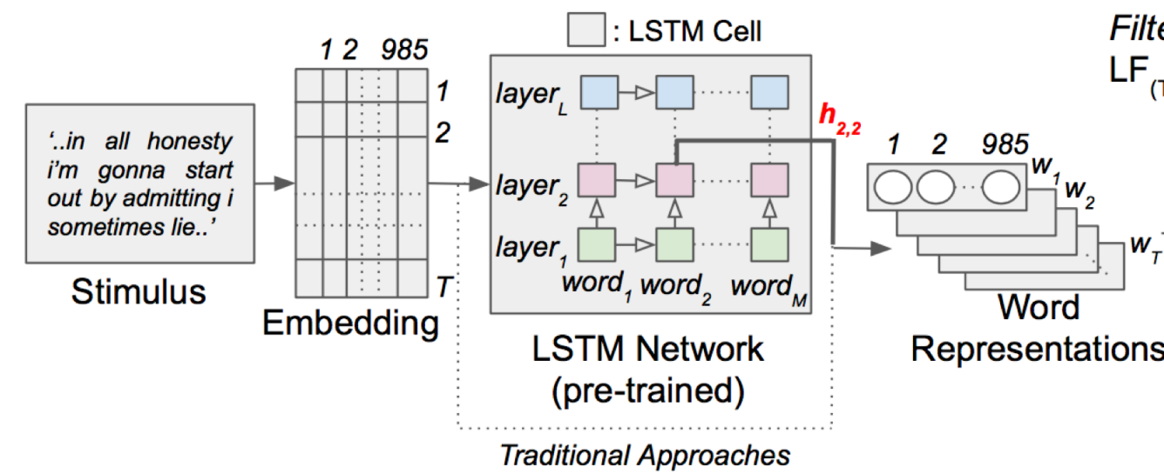
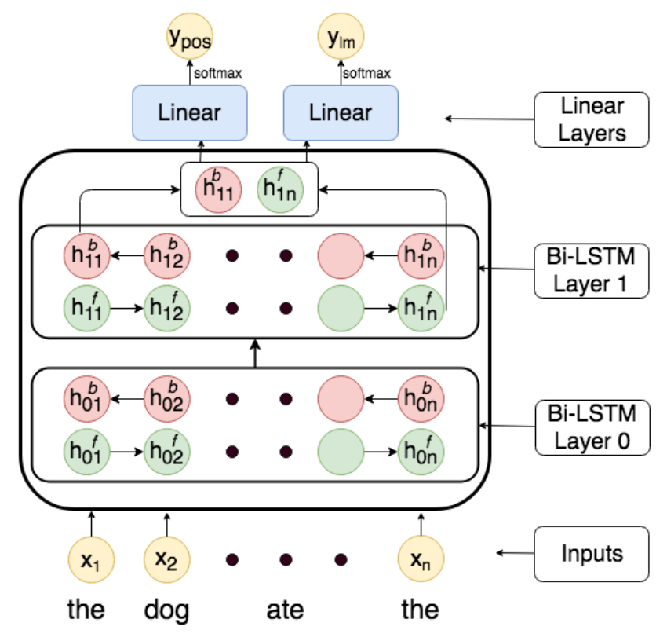
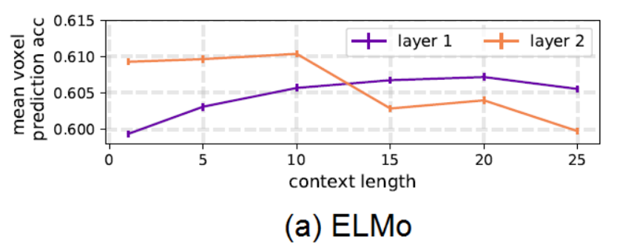
DL Representations: Using longer context for word stimuli
Multi-task LSTMs
Predict next word and POS of next word.
ELMo embeddings: LSTM based pretrained language model
Toneva, Mariya, and Leila Wehbe. "Interpreting and improving natural-language processing (in machines) with natural language-processing (in the brain)." Advances in Neural Information Processing Systems 32 (2019).
Jain, Shailee, and Alexander Huth. "Incorporating context into language encoding models for fMRI." Advances in neural information processing systems 31 (2018).
Jat, Sharmistha, Hao Tang, Partha Talukdar, and Tom Mitchell. "Relating simple sentence representations in deep neural networks and the brain." arXiv preprint arXiv:1906.11861 (2019).

Slide 25
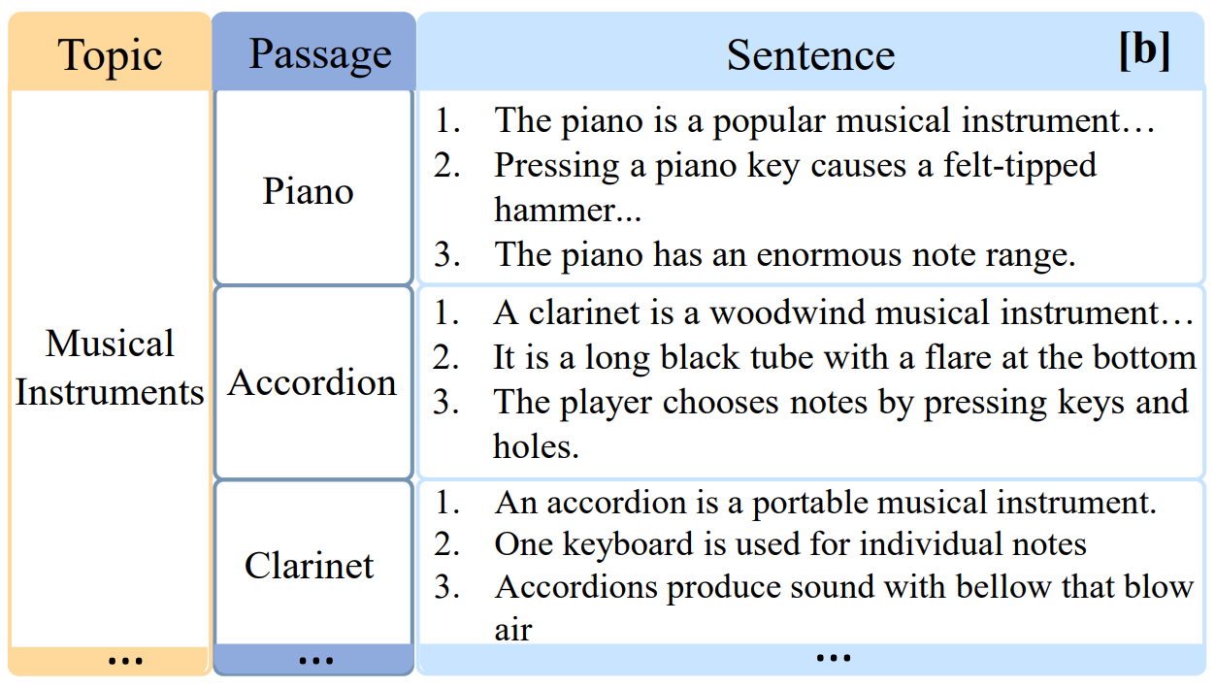
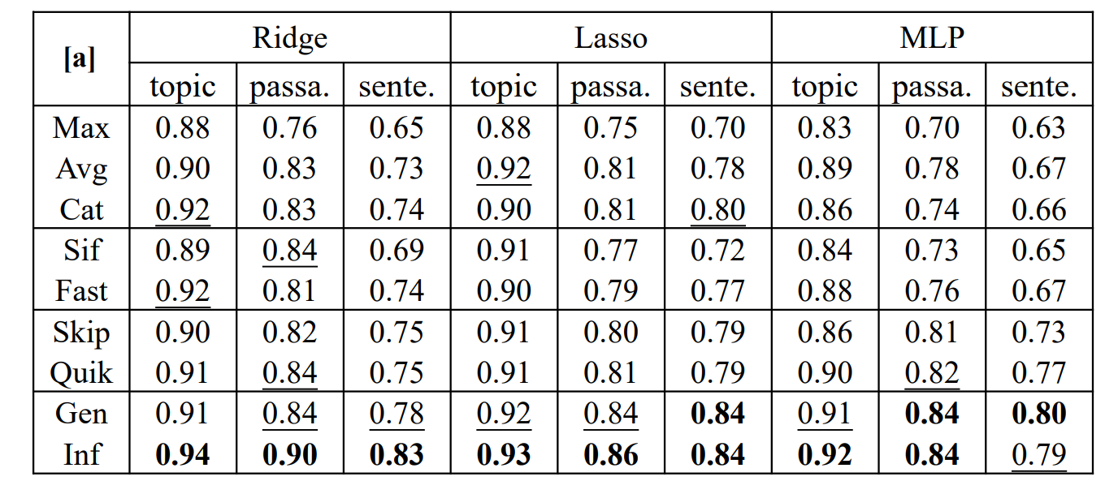
DL Representations: Using sentence embeddings
Unstructured Models: Ignore sentence structure
Simple Pooling Methods
Average/max/concat(max, avg) pooling over word embeddings.
Advanced Pooling Methods
FastSent (Hill, Cho, and Korhonen 2016) sums word embeddings in a sentence as its representation to predict the surrounding sentences.
SIF (Arora, Liang, and Ma 2016) adapts the naïve averaging of word embeddings to weighted averaging.
Structured Models
Unsupervised Methods: Skip-thought, QuickThought.
Supervised Methods: InferSent, GenSen (Subramanian et al. 2018), Universal Sentence Encoder
Toneva, Mariya, and Leila Wehbe. "Interpreting and improving natural-language processing (in machines) with natural language-processing (in the brain)." Advances in Neural Information Processing Systems 32 (2019).
Sun, Jingyuan, Shaonan Wang, Jiajun Zhang, and Chengqing Zong. "Towards sentence-level brain decoding with distributed representations." In Proceedings of the AAAI Conference on Artificial Intelligence, vol. 33, no. 01, pp. 7047-7054. 2019.

Slide 26
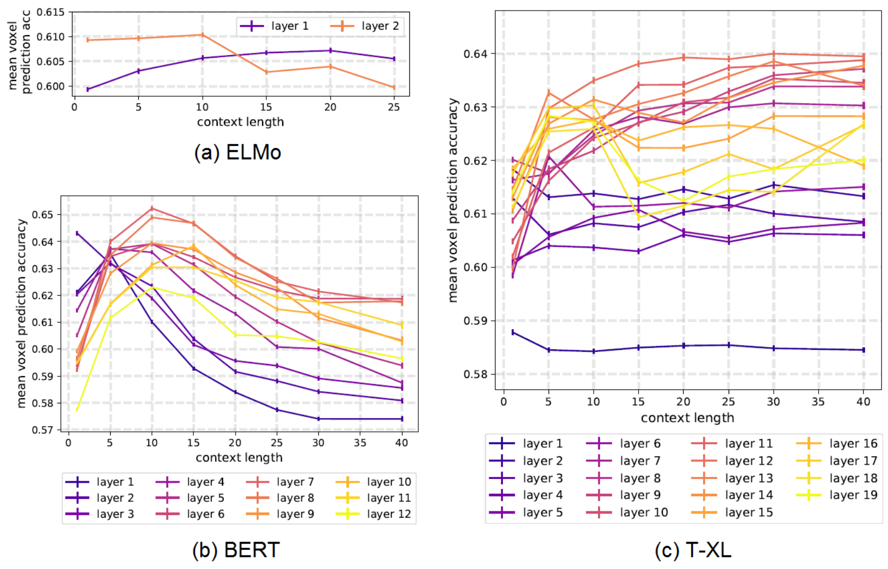
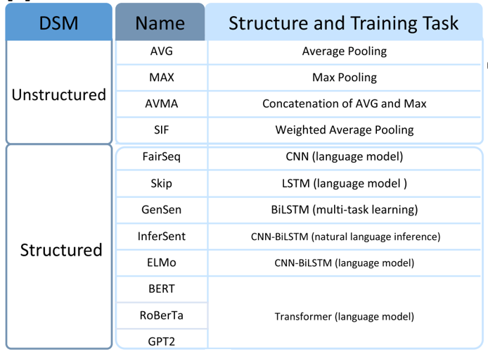
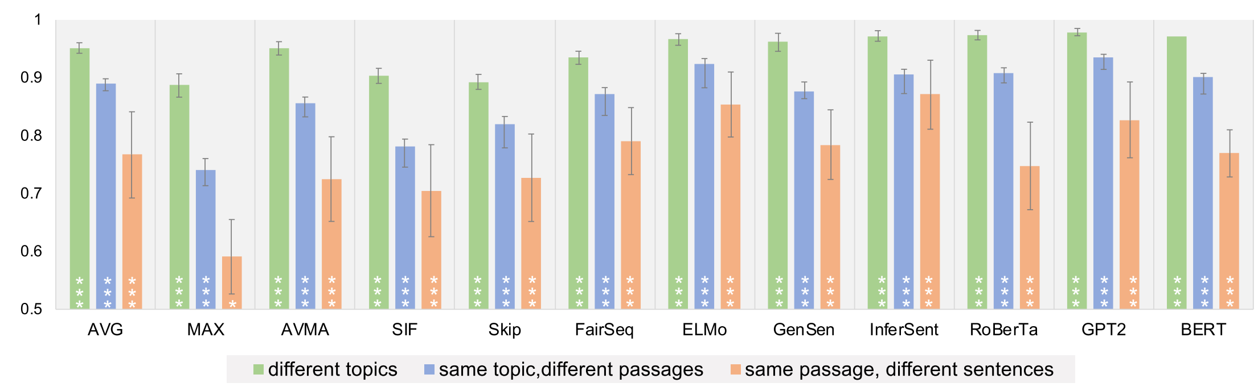
DL Representations: Transformer-based methods for text stimuli (Layer #, context length, architecture)
Transformer-XL is the only model that continues to increase performance as the context length is increased. In all networks, the middle layers perform the best for contexts longer than 15 words. The deepest layers across all networks show a sharp increase in performance at short-range context (fewer than 10 words), followed by a decrease in performance. [Toneva and Wehbe, 2019]
Toneva, Mariya, and Leila Wehbe. "Interpreting and improving natural-language processing (in machines) with natural language-processing (in the brain)." Advances in Neural Information Processing Systems 32 (2019).
Sun, Jingyuan, Shaonan Wang, Jiajun Zhang, and Chengqing Zong. "Neural encoding and decoding with distributed sentence representations." IEEE Transactions on Neural Networks and Learning Systems 32, no. 2 (2020): 589-603.

Slide 27
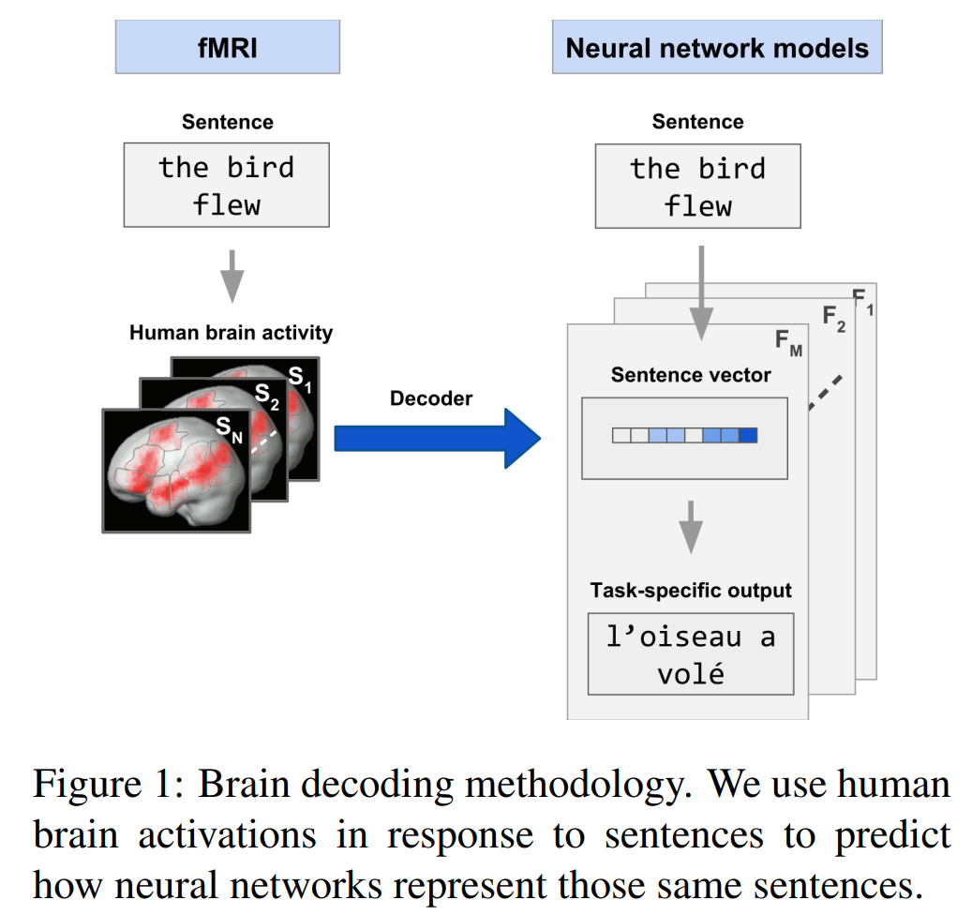
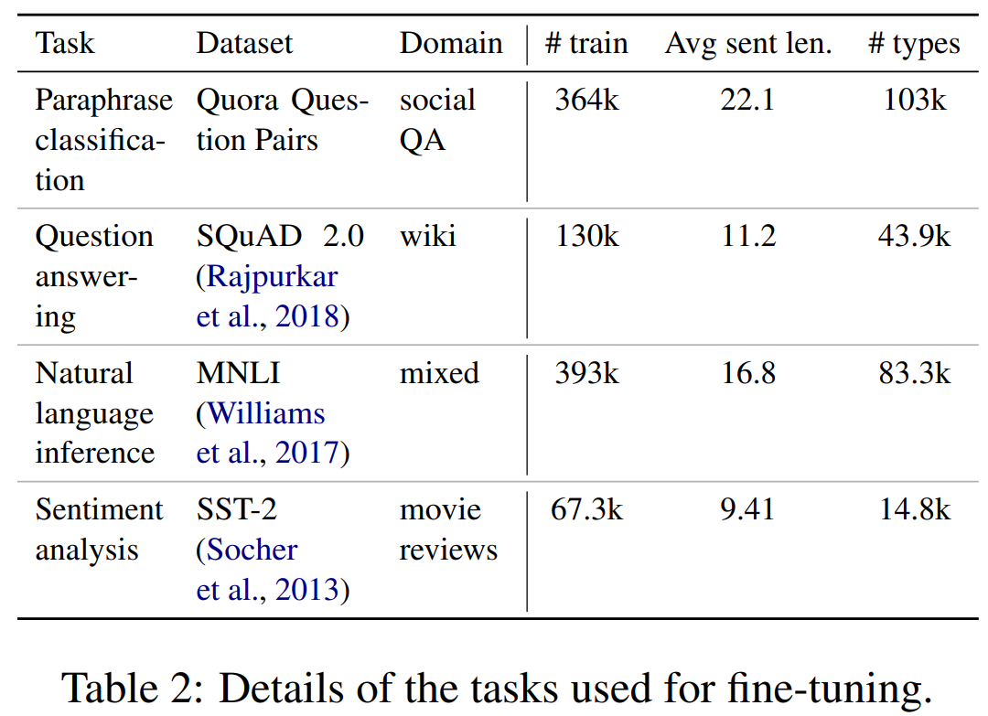
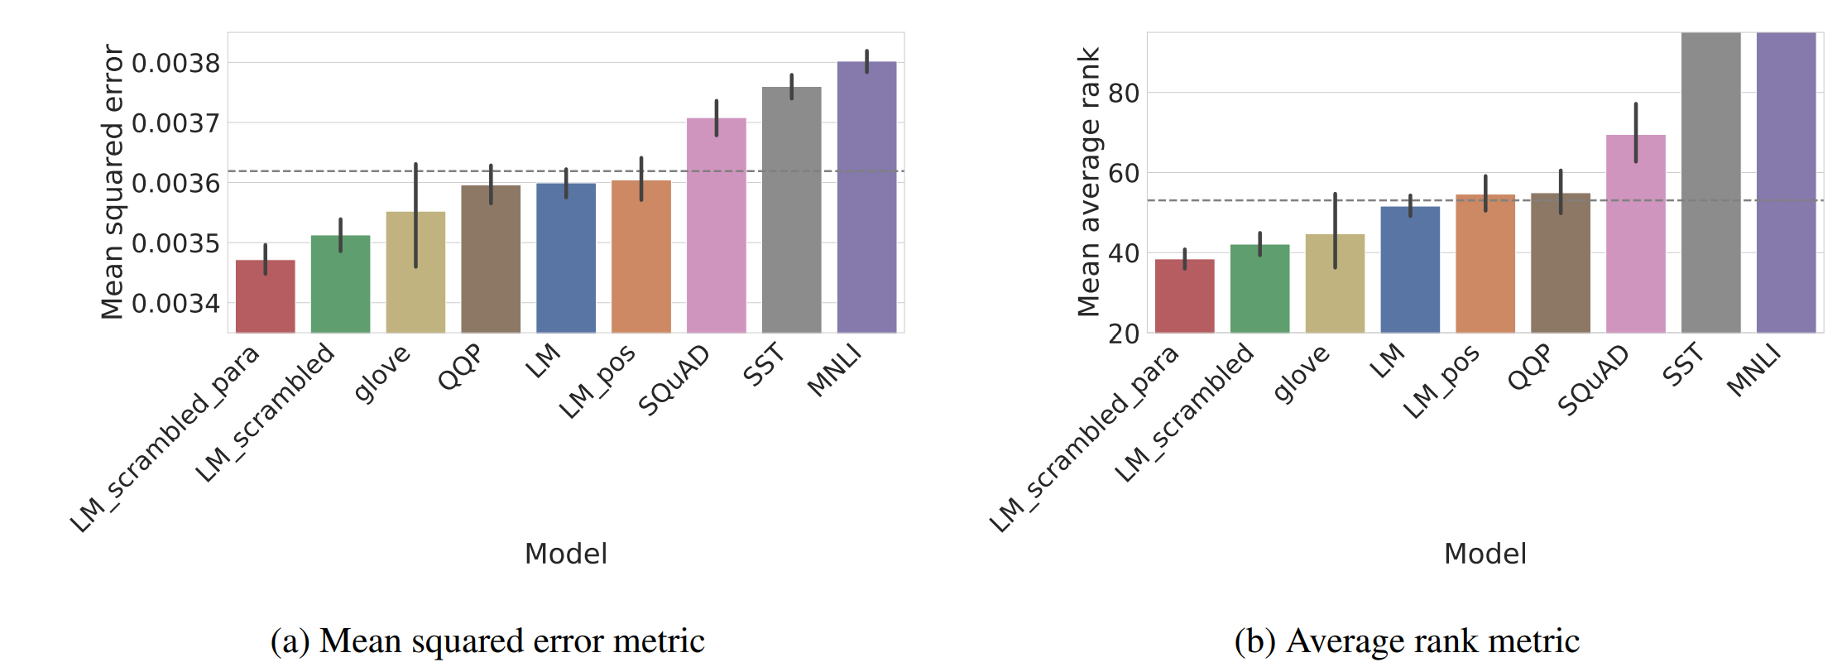
DL Representations: Transformer-based methods for text stimuli (NLP task finetuning and scrambled LM)
Scrambled LM
Randomly shuffle words from the corpus samples, to remove all first order cues to syntactic structure.
LM-scrambled: words are shuffled within sentences
LM-scrambled-para: words are shuffled within their containing paragraphs in the corpus.
LM_pos: predict only the part of speech of a masked word, rather than the word itself.
Scrambled LMs work best!
Gauthier, Jon, and Roger Levy. "Linking artificial and human neural representations of language." arXiv preprint arXiv:1910.01244 (2019).

Slide 28
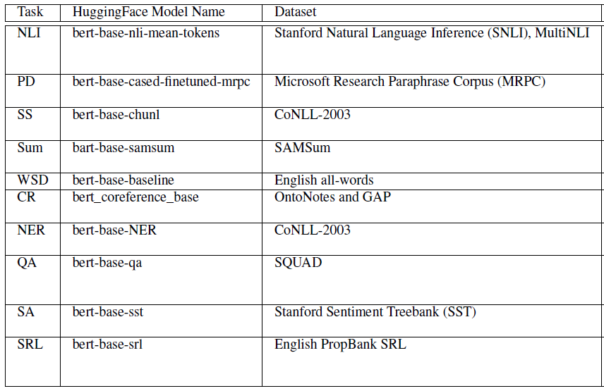
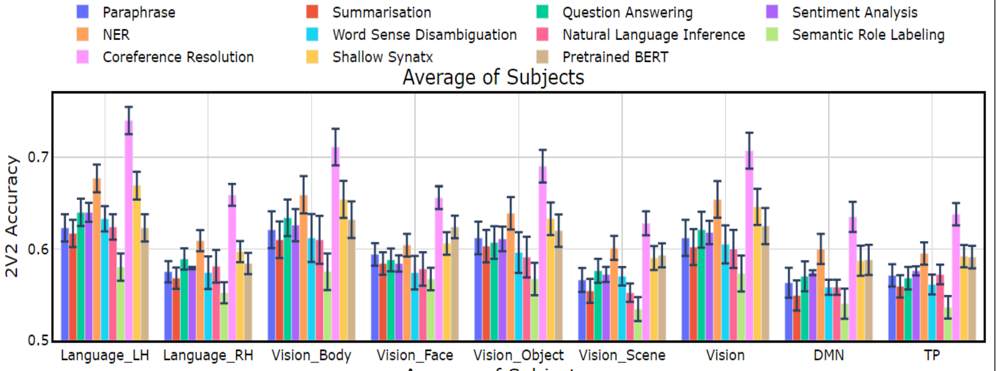
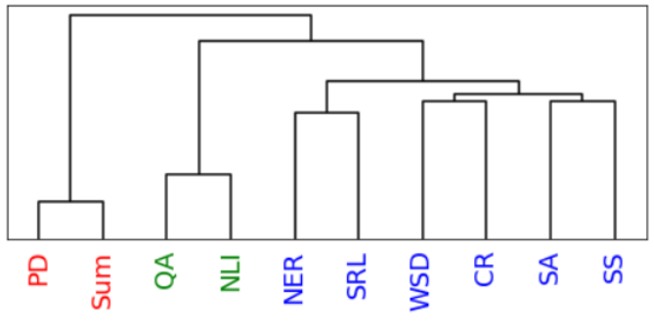
DL Representations: Transformer-based methods for text stimuli (NLP task finetuning)
Pereira dataset: CR, NER, and SS perform the best.
Tasks
Paraphrase, Summarization, Question Answering, Sentiment Analysis, NER, Word Sense Disambiguation, Natural Language Inference, Semantic Role Labeling, Coreference Resolution, Shallow Syntax Parsing
Dendrogram constructed using similarity on representations from task-specific Transformer encoder models with stimuli from the dataset passed as input.
Oota, Subba Reddy, Jashn Arora, Veeral Agarwal, Mounika Marreddy, Manish Gupta, and Bapi Raju Surampudi. "Neural Language Taskonomy: Which NLP Tasks are the most Predictive of fMRI Brain Activity?." arXiv preprint arXiv:2205.01404 (2022).

Slide 29
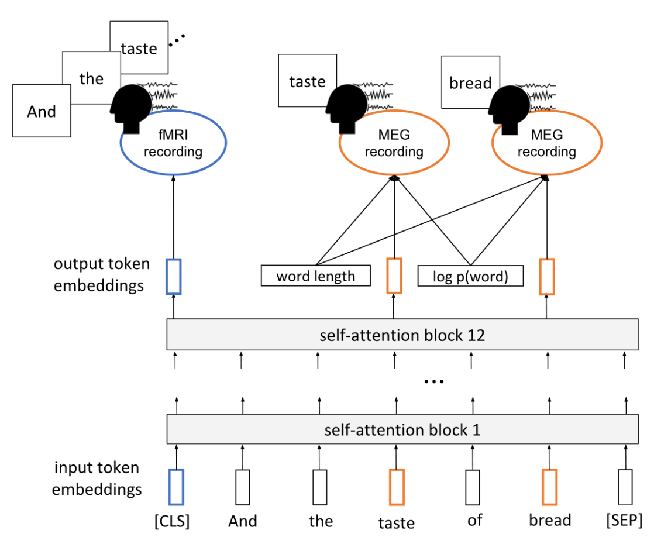
DL Representations: Transformer-based methods for text stimuli (Multi-task setup)
Settings
Finetune BERT vs not
Finetune BERT using one representative subject and train dense layer for each subject, vs finetune BERT for each subject.
Finetune BERT on MEG for all subjects, then finetune BERT on fMRI.
Multi-task finetune BERT for fMRI+MEG prediction task
Results
Fine-tuned models predict fMRI data better than vanilla BERT
Relationships between text and brain activity generalize across experiment participants.
Using MEG data can improve fMRI predictions.
A single model can be used to predict fMRI activity across multiple experiment participants.
Schwartz, Dan, Mariya Toneva, and Leila Wehbe. "Inducing brain-relevant bias in natural language processing models." Advances in neural information processing systems 32 (2019).

Slide 30
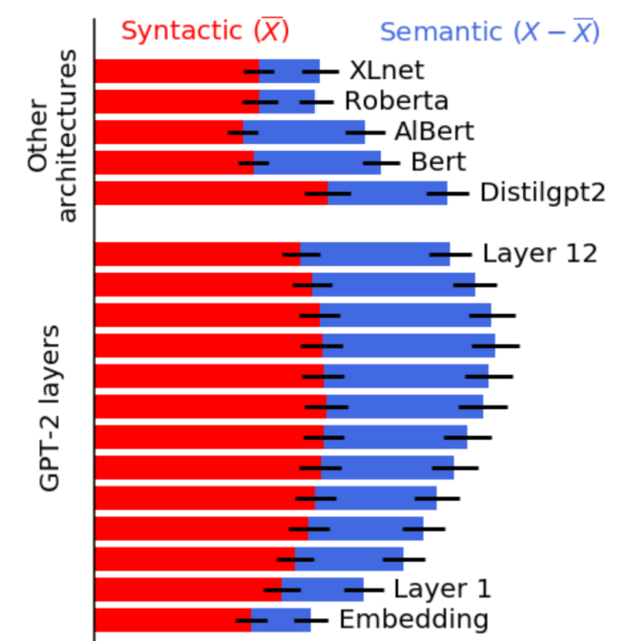
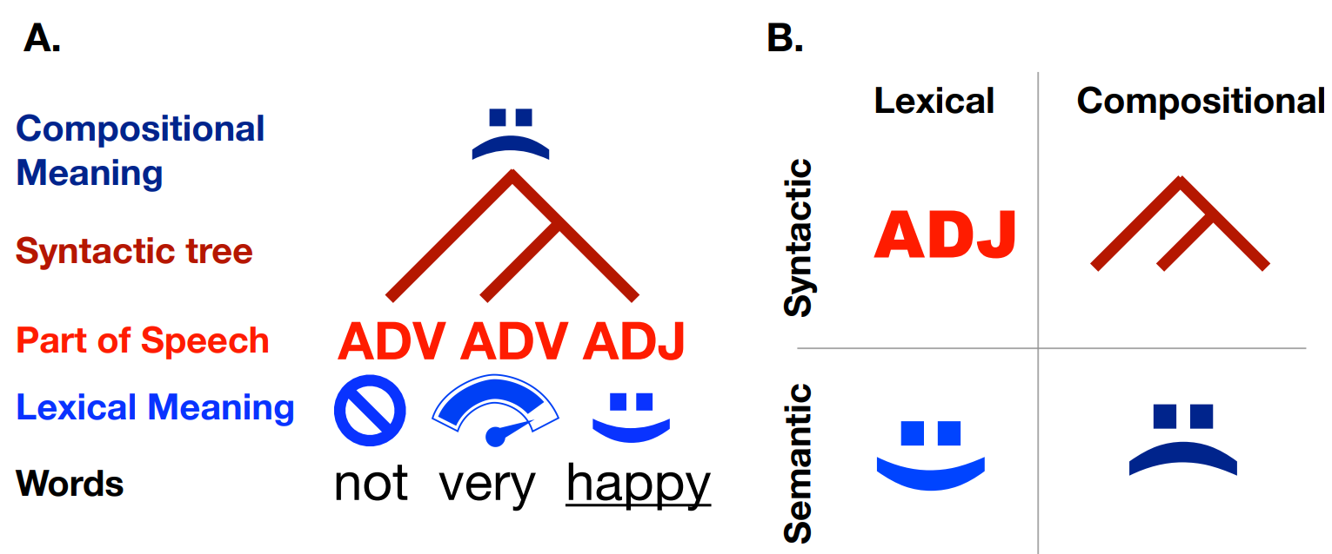
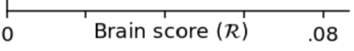
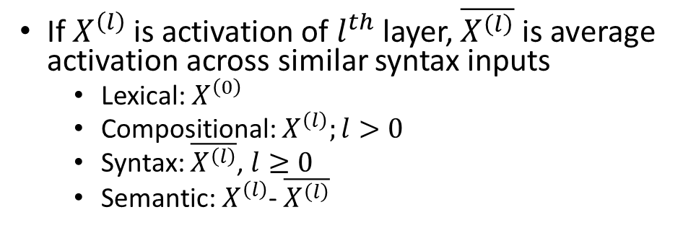
DL Representations: Comparing Transformers and extracting syntax vs semantics
Representations:
Lexical: representation that is context-invariant. E.g., word embeddings.
Compositional: “contextualized” representation generated by a system combining multiples words. E.g., parse trees
Syntax: representation associated with the structure of sentences independently of their meaning
Semantics: representation of a language system that are not syntactic.
If $X^{\left(l\right)}$ is activation of $l^{th}$ layer, $\overline{X^{\left(l\right)}}$ is average activation across similar syntax inputs
Lexical: $X^{\left(0\right)}$
Compositional: $X^{\left(l\right)};l>0$
Syntax: $\overline{X^{\left(l\right)}}$, $l≥0$
Semantic: $X^{\left(l\right)}$- $\overline{X^{\left(l\right)}}$
Caucheteux, Charlotte, Alexandre Gramfort, and Jean-Remi King. "Disentangling syntax and semantics in the brain with deep networks." In International Conference on Machine Learning, pp. 1336-1348. PMLR, 2021.

Slide 31
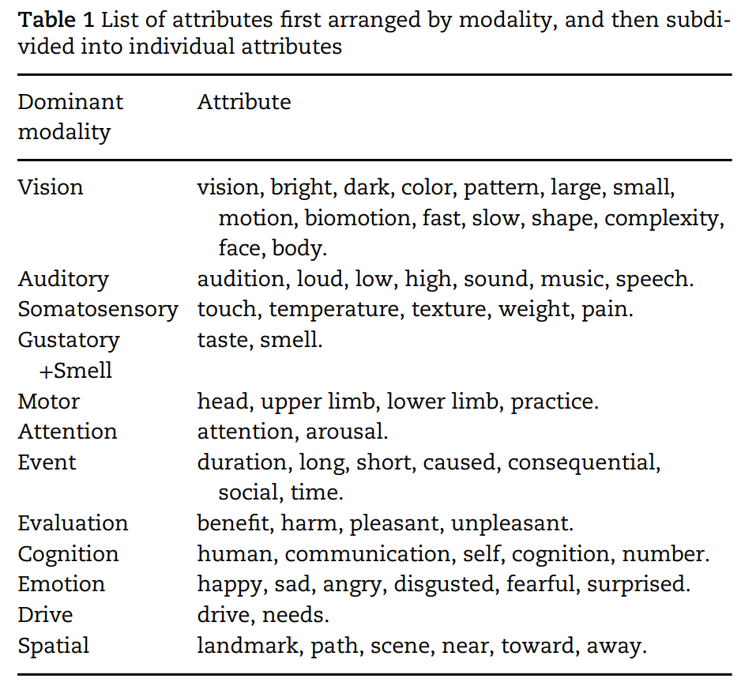
Experiential attributes model for text stimuli
Represents words in terms of human (Amazon Mechanical Turk) ratings of their degree of association with different attributes of experience
“On a scale of 0 to 6, to what degree do you think of a banana as having a characteristic or defining color?”
Anderson et al., 2019: 65 attributes spanning sensory, motor, affective, spatial, temporal, causal, social, and abstract cognitive experiences.
Value-add on top of text models: a lot of experiential information goes unstated in natural verbal communication.
E.g., it is rarely useful to communicate the color of bananas because it is obvious to all those with experience of bananas.
E.g., it would be unusual to specify that dropping things involves movement.
Nishida et al., 2020 use a subset of 20 attributes.
Anderson, Andrew James, Jeffrey R. Binder, Leonardo Fernandino, Colin J. Humphries, Lisa L. Conant, Rajeev DS Raizada, Feng Lin, and Edmund C. Lalor. "An integrated neural decoder of linguistic and experiential meaning." Journal of Neuroscience 39, no. 45 (2019): 8969-8987.
Anderson, Andrew James, Jeffrey R. Binder, Leonardo Fernandino, Colin J. Humphries, Lisa L. Conant, Mario Aguilar, Xixi Wang, Donias Doko, and Rajeev DS Raizada. "Predicting neural activity patterns associated with sentences using a neurobiologically motivated model of semantic representation." Cerebral Cortex 27, no. 9 (2017): 4379-4395.
Anderson, Andrew James, Kelsey McDermott, Brian Rooks, Kathi L. Heffner, David Dodell-Feder, and Feng V. Lin. "Decoding individual identity from brain activity elicited in imagining common experiences." Nature communications 11, no. 1 (2020): 1-14.

Slide 32
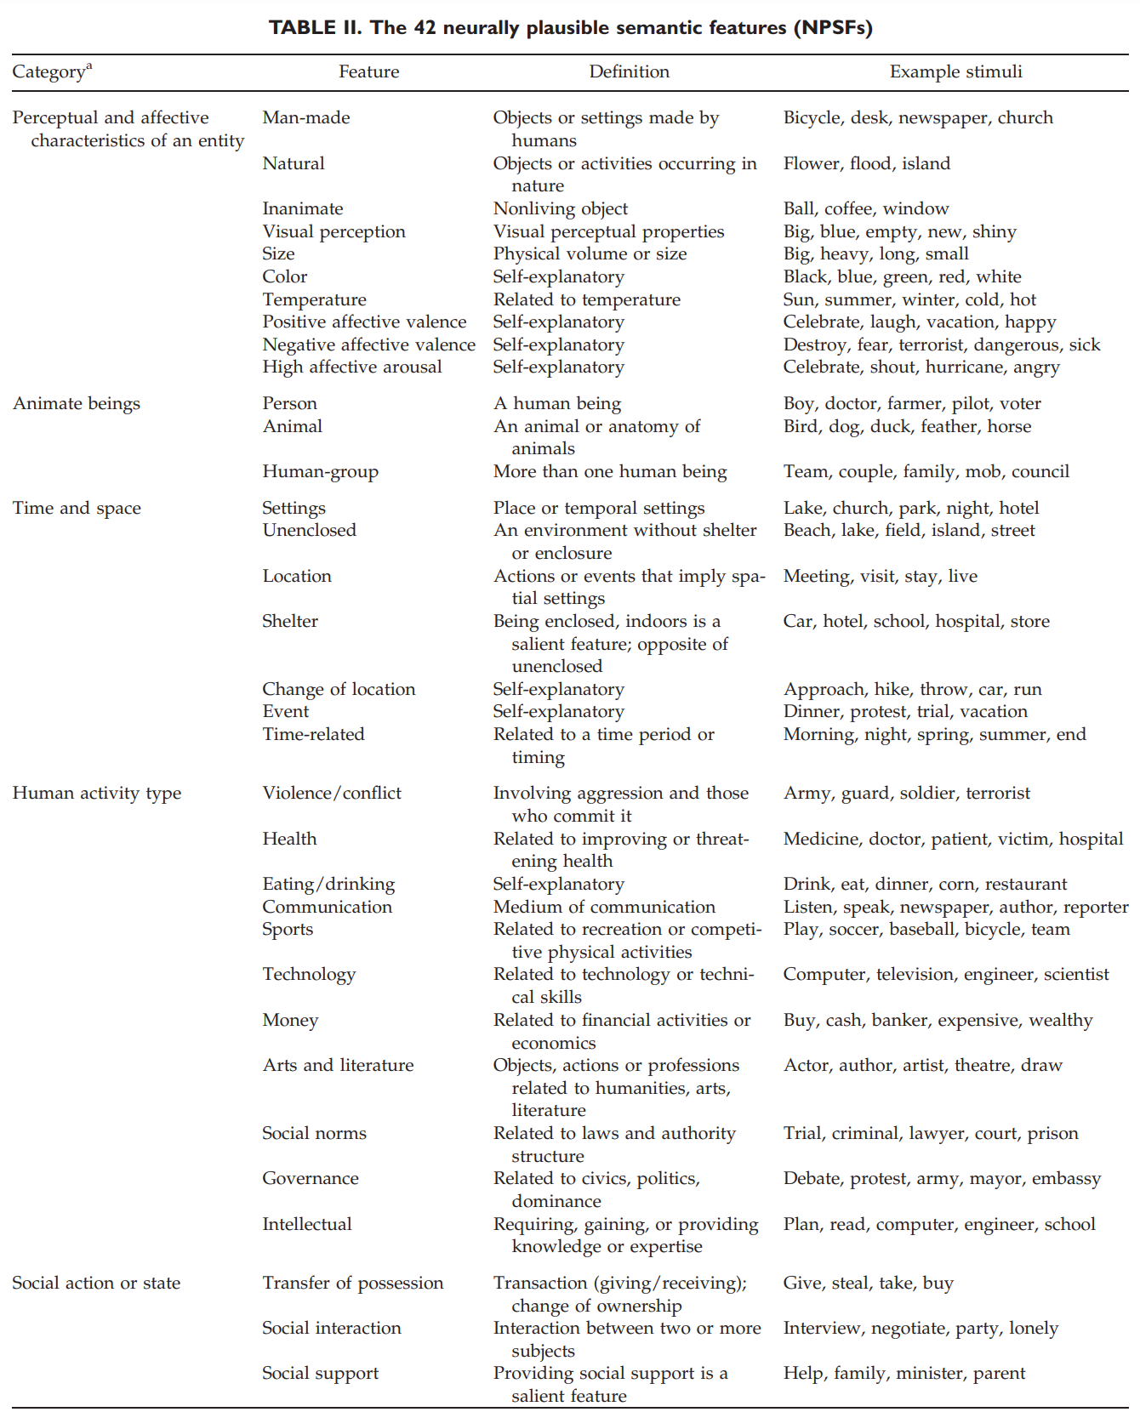
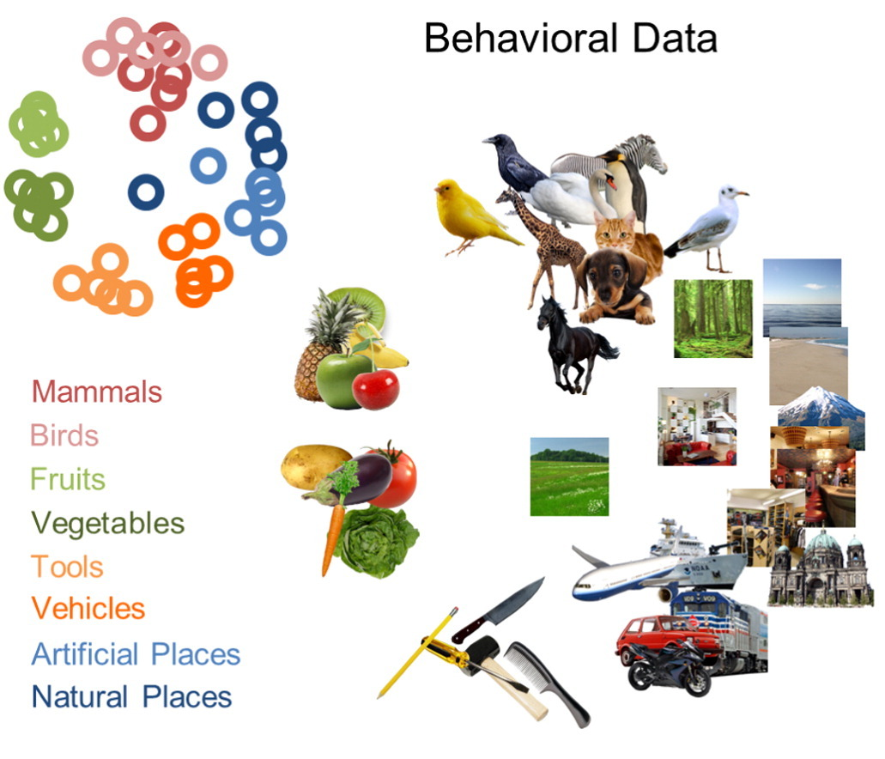
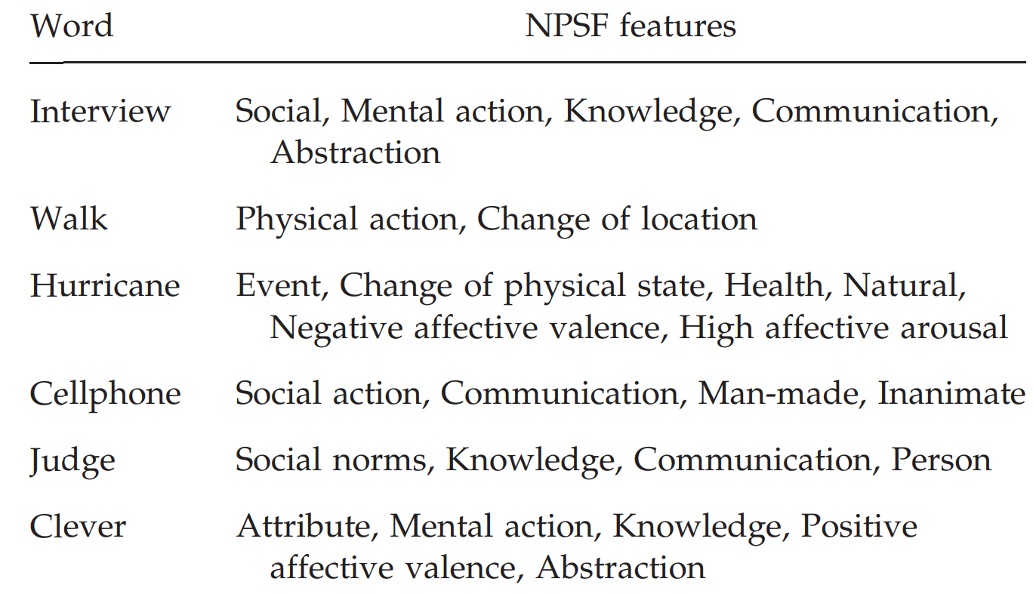
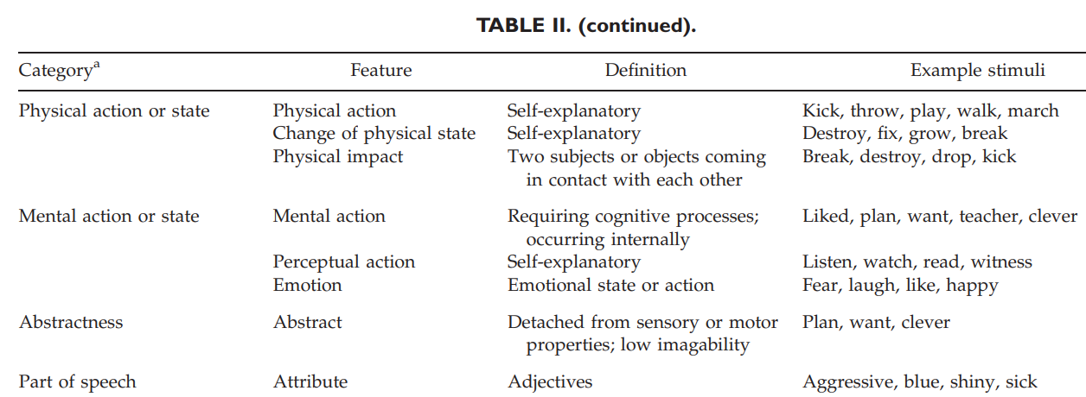
Binary attribute representations
Each stimulus is represented using a binary vector capturing membership to one of the eight semantic categories.
42 neurally plausible semantic features (NPSFs)
Perceptual and affective characteristics of an entity (10 NPSFs coded such features, such as man-made, size, color, temperature, positive affective valence, high affective arousal), animate beings (person, human-group, animal), and time and space properties (e.g. unenclosed setting, change of location)
Handjaras, Giacomo, Emiliano Ricciardi, Andrea Leo, Alessandro Lenci, Luca Cecchetti, Mirco Cosottini, Giovanna Marotta, and Pietro Pietrini. "How concepts are encoded in the human brain: a modality independent, category-based cortical organization of semantic knowledge." Neuroimage 135 (2016): 232-242.
Wang, Jing, Vladimir L. Cherkassky, and Marcel Adam Just. "Predicting the brain activation pattern associated with the propositional content of a sentence: modeling neural representations of events and states." Human brain mapping 38, no. 10 (2017): 4865-4881.

Slide 33
Agenda
Neuro-AI Alignment: Introduction
Brain Encoding/Decoding: Techniques and Research Goals
Introduction to popular text datasets
Text Stimulus Representations

Slide 34
Agenda
09.30 AM – 11.15 AM Bapi Raju Neuro-AI alignment: Introduction
11.15 AM – 11.30 AM Coffee Break
11.30 AM – 1.00 PM Subba Reddy Similarities and differences between language processing in brains and machines
1.00 PM – 2.00 PM Lunch Break
2.00 PM – 3.30 PM Mounika Marreddy Recent trends in LLMs
3.30 PM – 3.45 PM Coffee Break
3.45 PM – 5.45 PM Subba & Mounika Hands-on-session

Slide 35
Thanks!
Questions
subba-reddy.oota@inria.fr
raju.bapi@iiit.ac.in
Connect with us:
https://www.linkedin.com/in/subba-reddy-oota-11a91254/
https://sites.google.com/view/bccl-iiith/home

